Slide 1

Car Dealership
By: Jordan Georgiev & Anna Ilieva

Slide 2

TABLE OF CONTENTS
01
Purpose of the project
03
Features
What is this application for?
Let’s see what the program can do
02
Architecture of the project
04
Future Development
The main components of the application
How the project will improve in the near future

Slide 3
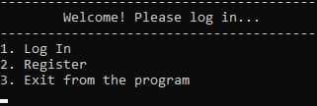
Purpose of the project
01
What is this application for?
- Organize the work in a car dealership
- Better accounting of items in stock
- Тrack employee progress

Slide 4
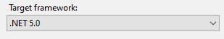
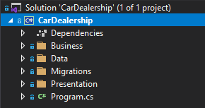
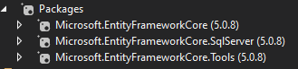
Architecture of the project
02
The main components of the application
This is a Console Application with ORM (Object-Role Modeling) architecture.

Slide 5
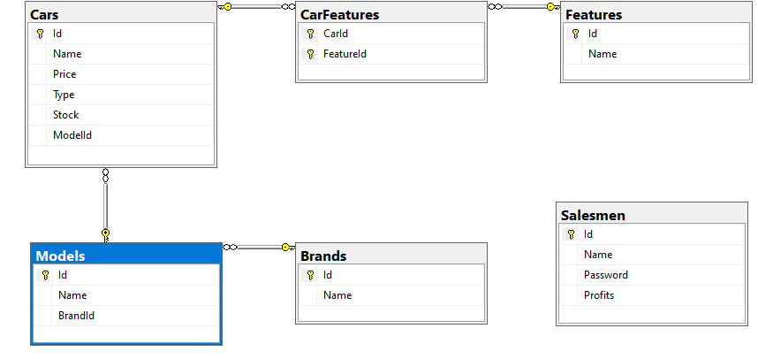
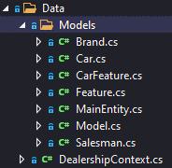
Architecture of the project
02
The main components of the application
- SQL Database – SQL Server Management Studio
- Each car has a model and some features
- Salesmen sell cars from those in stock

Slide 6
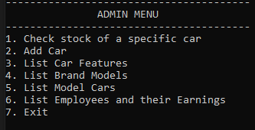
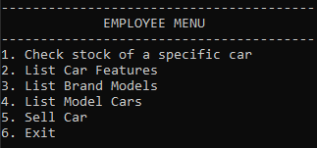
Features
03
Let’s see what the program can do
- Check stock– search for a car to check how many are available for sale
- Add Car – add a new car in stock
- List Car Features – shows all features of an available car.
- List Brand Models – shows all the models of one brand
-List Model Cars – lists all cars from a certain model

Slide 7

Future Development
04
How the project will improve in the near future
Better search
More features
Bigger database
and more…

Slide 8
THANK
YOU

